Slide 1
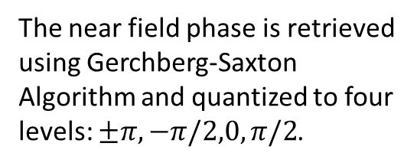
Far Field Image Generation (20 by 20 laser sites)
The near field phase is retrieved using Gerchberg-Saxton Algorithm and quantized to four levels: $±π, −π/2,0,π/2$.
Near Field Intensity (Uniform) and phase of the laser array
Desired pattern (left) and recovered pattern in the far field (Fourier Plane)
Assumed constant intensity maps for G-S iteration

Slide 2
Far Field Image Generation (20 by 20 laser sites)

